Slide 1



TrailFinder:
Your Personal Trail Assistant
Empowering Your Trail Adventure with Intelligent Trail Selection
Fall 2023 - INFO 5002 Final Project
Haoqi Shen, Xijing Zhang, Bailing Zhan

Slide 2
Navigating Trails Made Easy:
Addressing Challenges and Introducing TrailFinder
01 | Information Overload | - Overwhelmed by volume of trails available - Challenging to choose the most suitable one
02 | Lack of personalization | - Generic recommendations - Lack of personal touch, individual preference
03 | Difficulty in decision-making | - Insufficient information on trail features, conditions and user experience to make informed decision

Slide 3
Solution Overview: App features
Curated trails, no overload, find matches for your interests and skill level effortlessly.
Interactive and user-friendly chatbot guides personalized trail selection based on unique preferences.
01 Trail Selection
03 Chatbot Assistance
02 Filtering Options
Personalize search with advanced filters, including weather, duration, and distance for tailored information.

Slide 4

Introducing TrailFinder
App's Purpose:
TrailFinder aims to address the common challenges outdoor enthusiasts face when trying to find the perfect trail.
Whether you're a seasoned hiker or a novice explorer, TrailFinder is here to simplify the process of selecting the ideal trail, ensuring that each outdoor journey is as enjoyable and personalized as possible.
Key Features:
Trail Selection
Curated Selection of Trails
Weather Conditions
Filtering Options
Duration
Chatbot Assistance
Distance
... ...

Slide 5


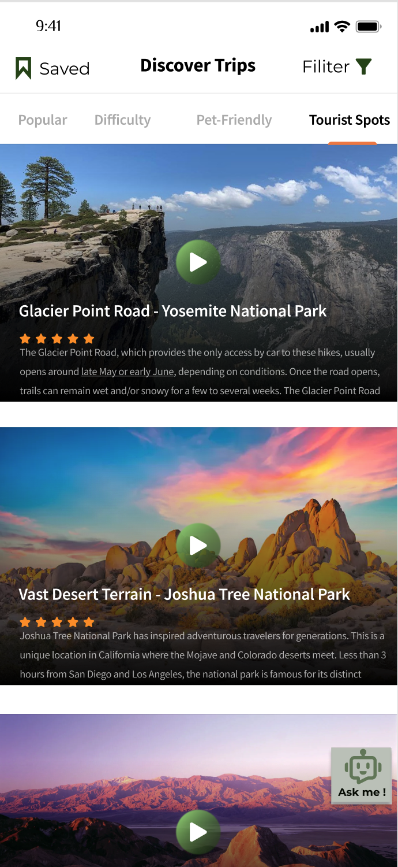
Trail Selection
Interface
Landing Page
Explore Page
Ease of Use:
Intuitive Navigation
At-a-Glance Information
Interactive Map
User-Friendly Design:
Simplified Filter
One-Click Selection
Feedback and Ratings

Slide 6
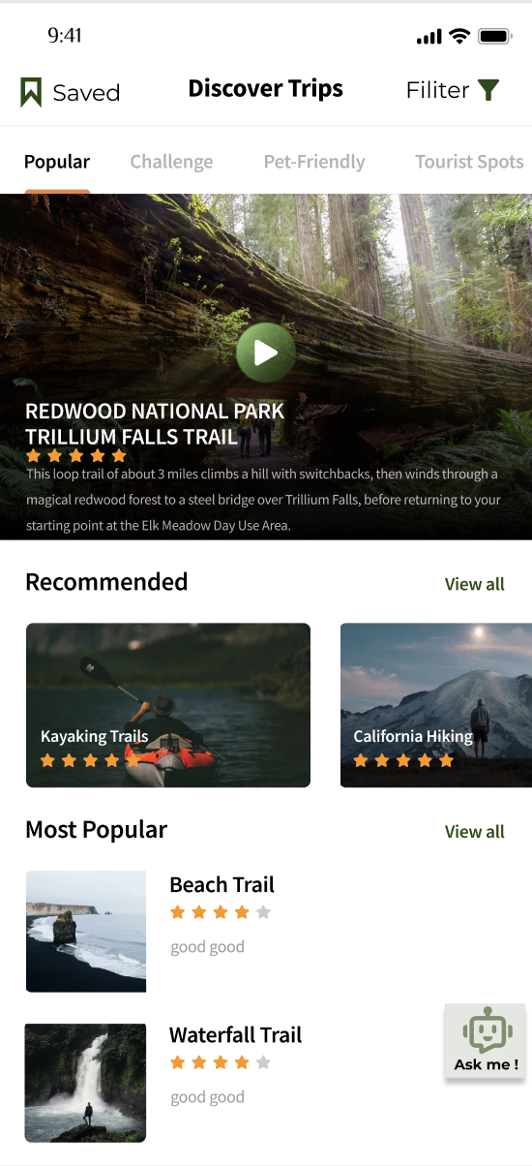
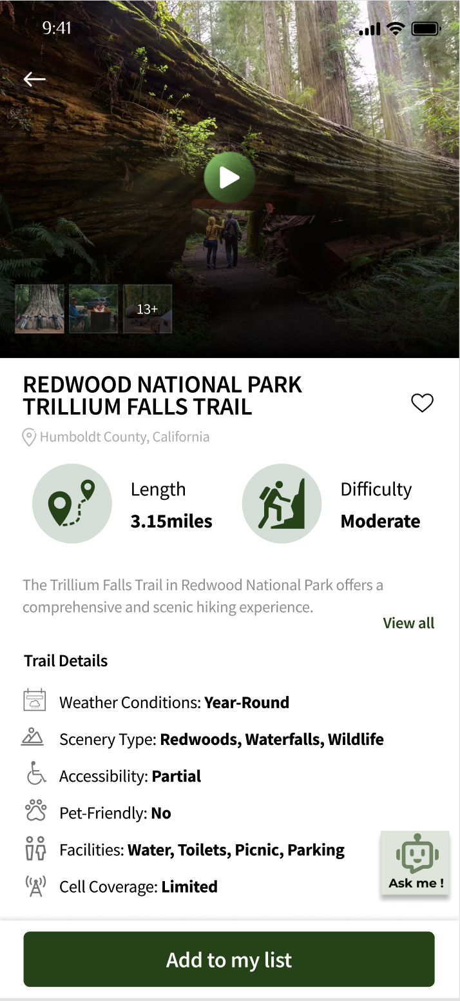
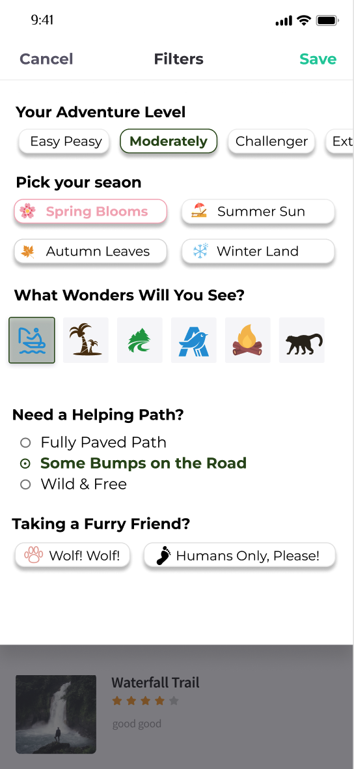
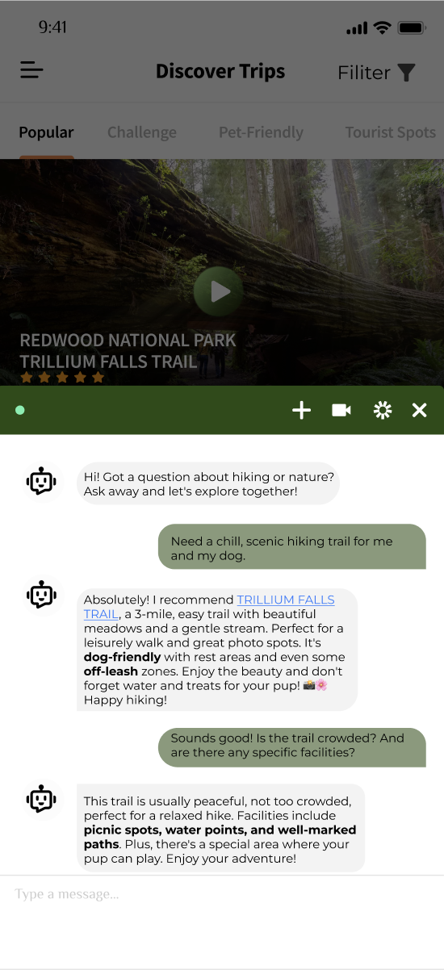
Intuitive Trail Selection:
A Seamless User Experience
Trail Selection
Filtering Options
Chatbot Assistance
Explore Page
Trail Detail Page
Filtering Feature
Realtime Chatbot
Prototype

Slide 7

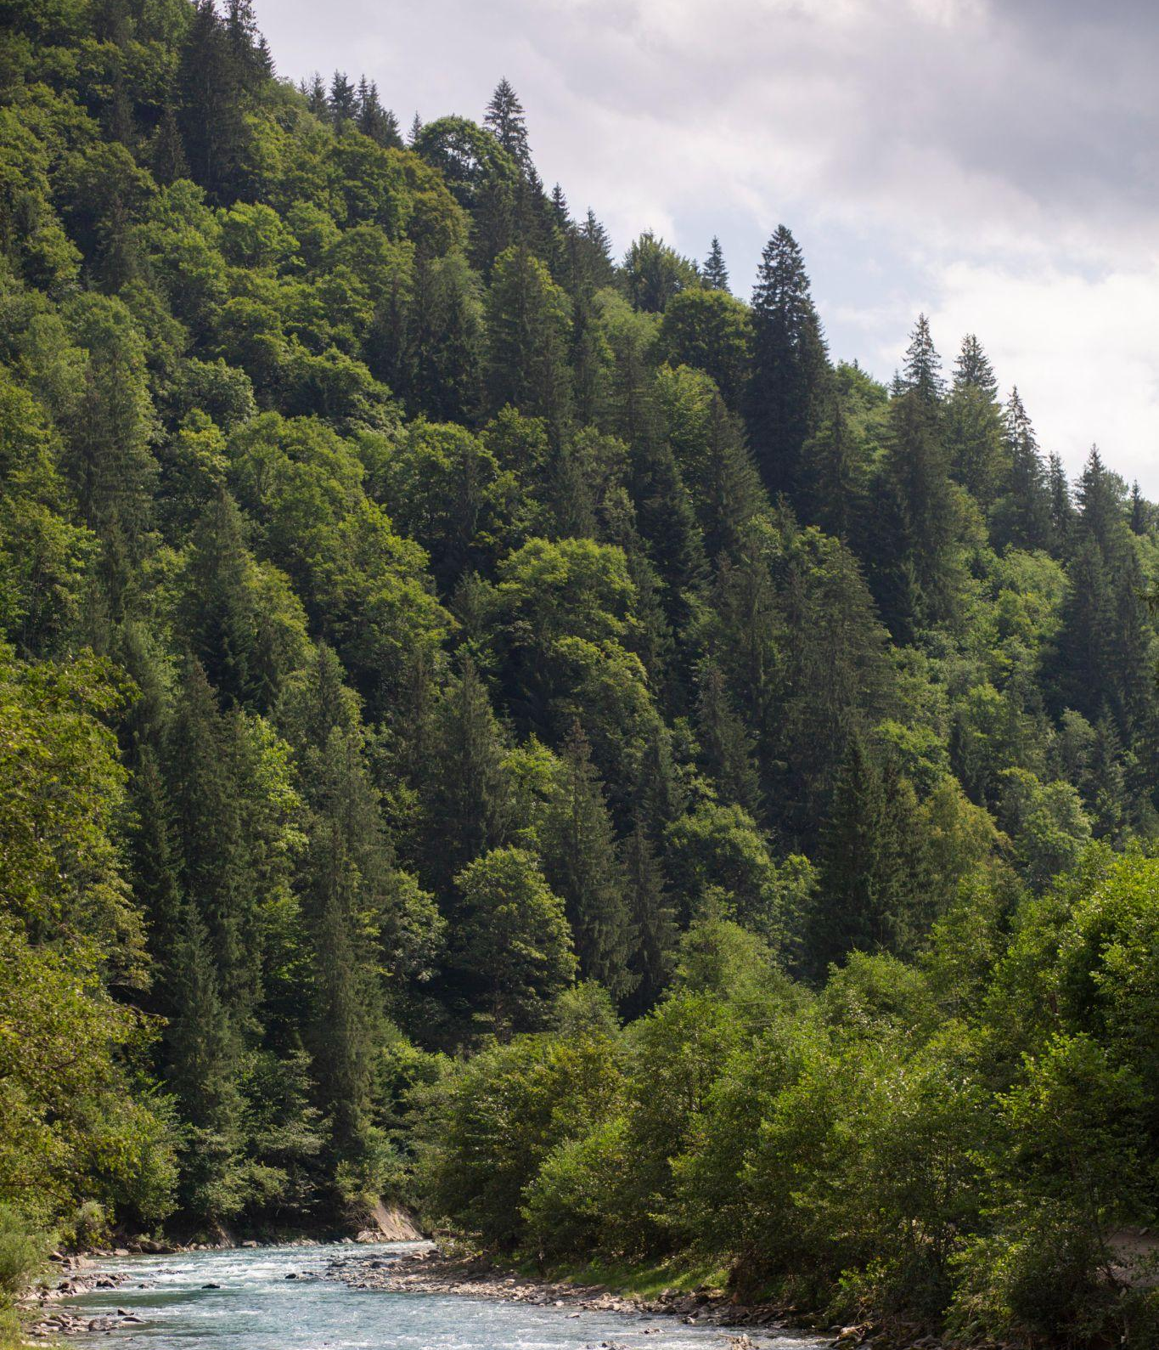
Filtering Options
Tailoring Trails to Your Preferences
01
id (INT)
02
trail (VARCHAR)
03
location (TEXT)
04
latitude (REAL)
05
longitude (REAL)
06
length (REAL)
07
difficulty (TEXT)
08
duration (REAL)
09
isKidFriendly (BOOLEAN)
10
isPetFriendly (BOOLEAN)
11
saved (BOOLEAN)

Slide 8
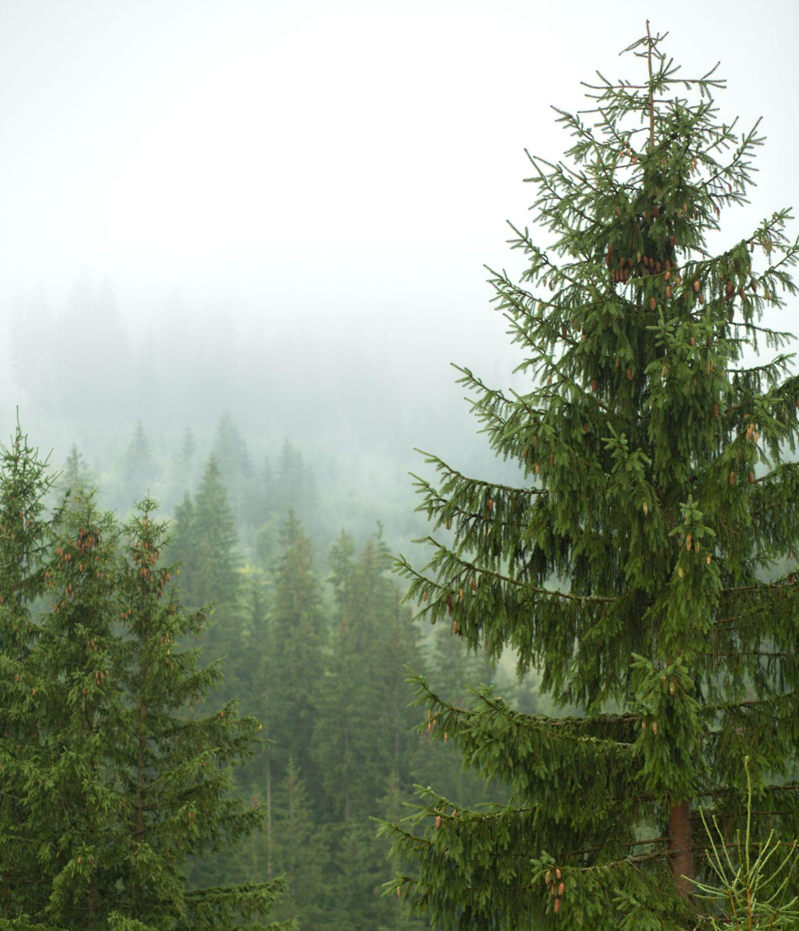
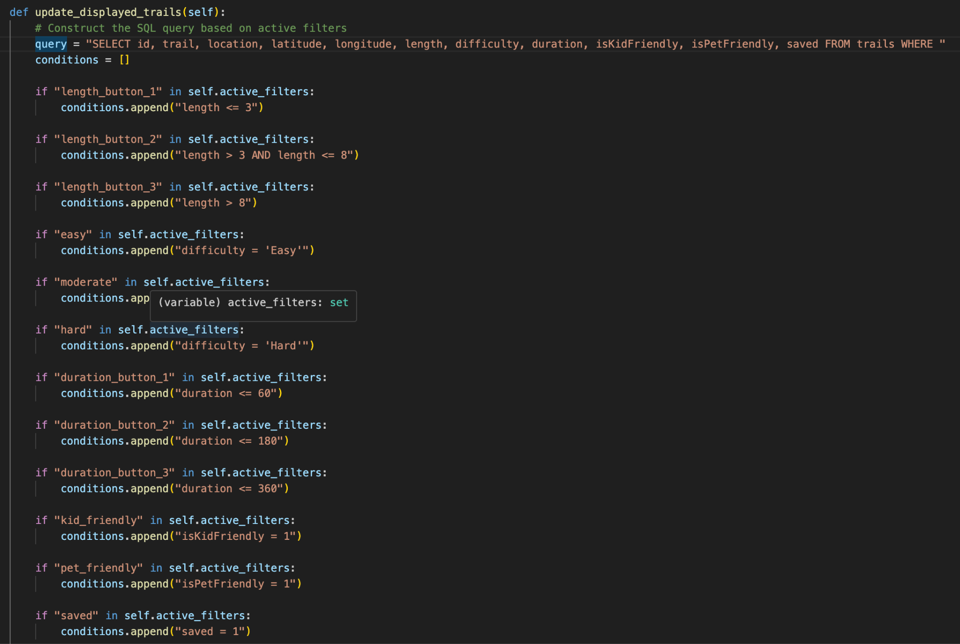
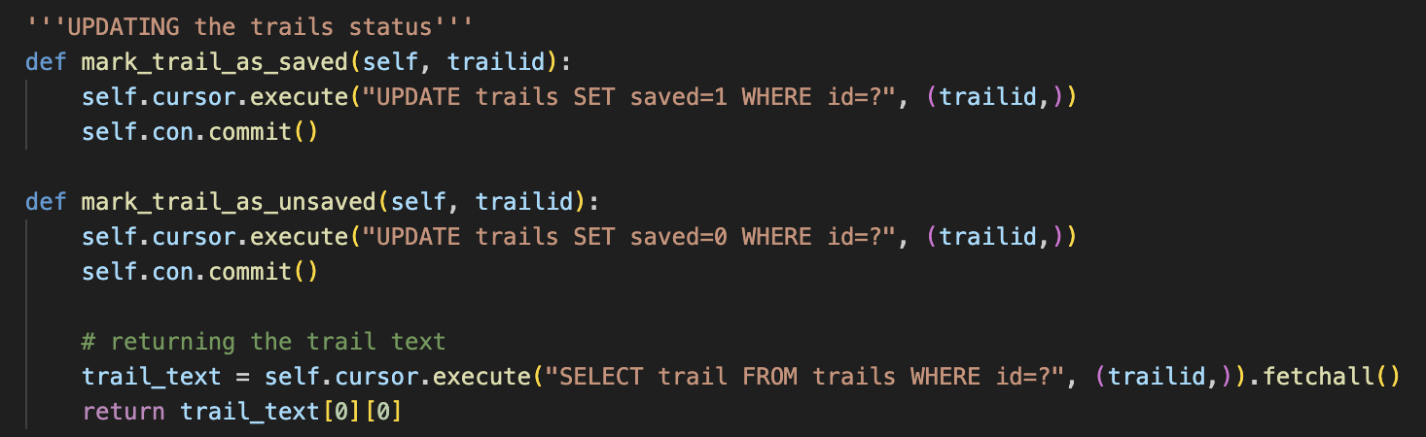

Python Code Demo
Implementing Filters and Parameters
Conditional function
on length/ difficulty/ duration/ kidFriendly/ petFriendly/ saved selections
Trail status updated to saved/ unsaved by user toggling

Slide 9
Personalized Guidance: (Future Iteration)
ChatGPT-powered Trail Selection Assistance
Chatbot Assistant
Assistance Users with No Idea:
Enhancing User Experience
Guidance of Novices
Personalized Recommendations
User-Friendly Interaction
Learning and Adapting
Role in Enhancing User Experience:
ChatBot Capabilities
Natural Language Understanding
Real-time Assistance
Streamlined Decision-Making
Comprehensive Assistance

Slide 10
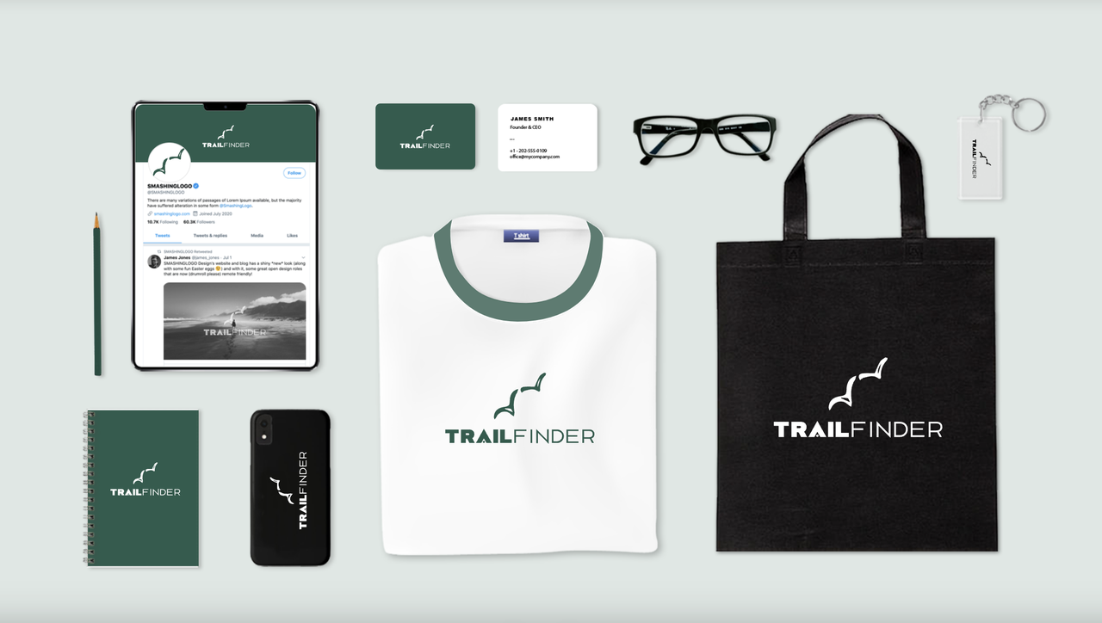
Future Development
Evolving for Your Trail Adventure
Potential Future Features:
Continuous Innovation
Integration with wearables
User Feedback and Suggestions:
User Input Matters
Community Collaborations

Slide 11
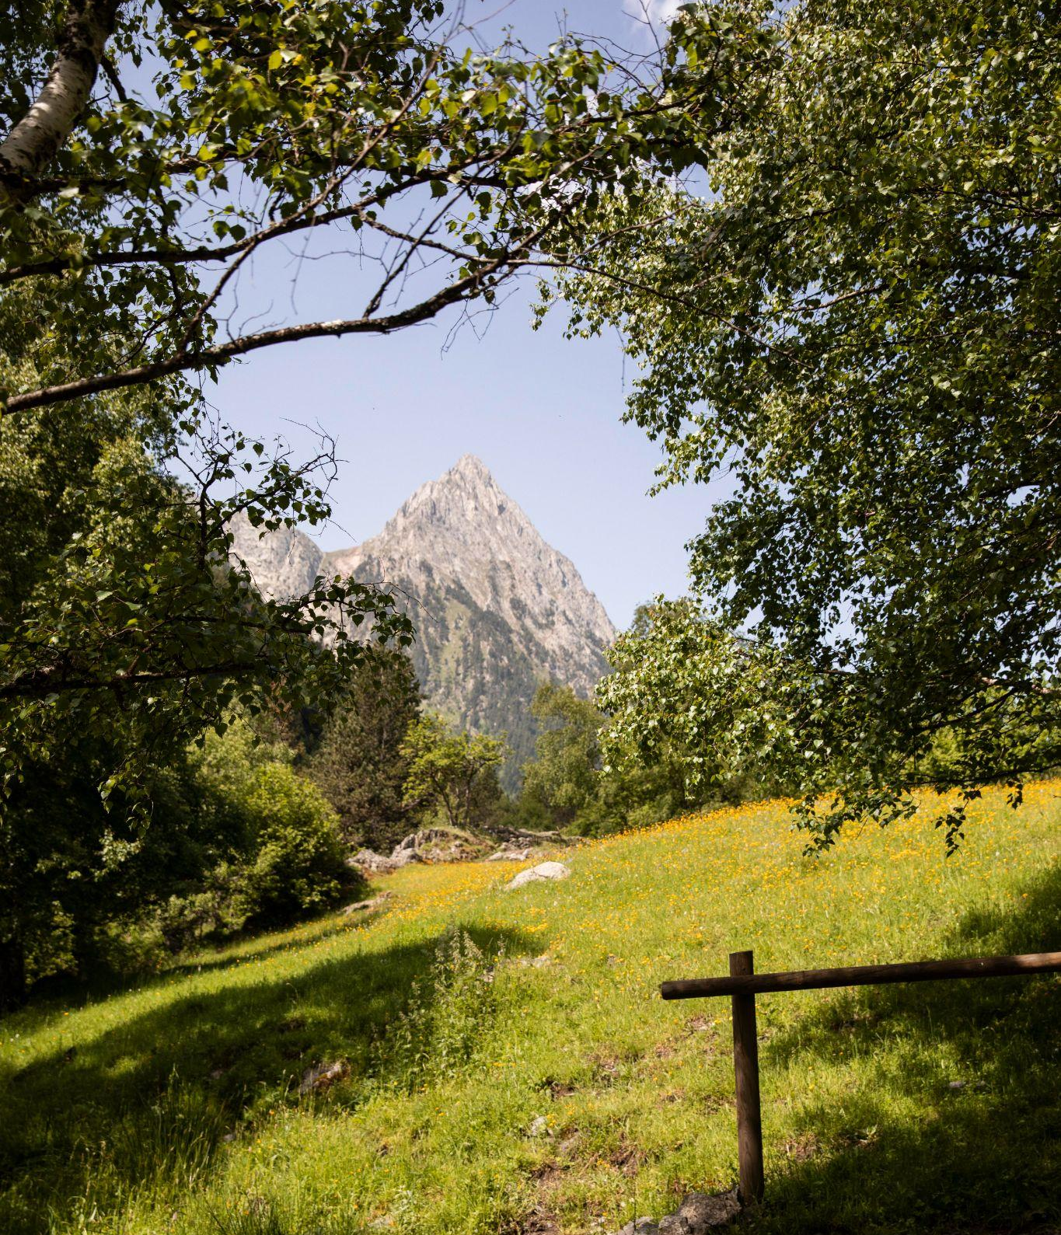
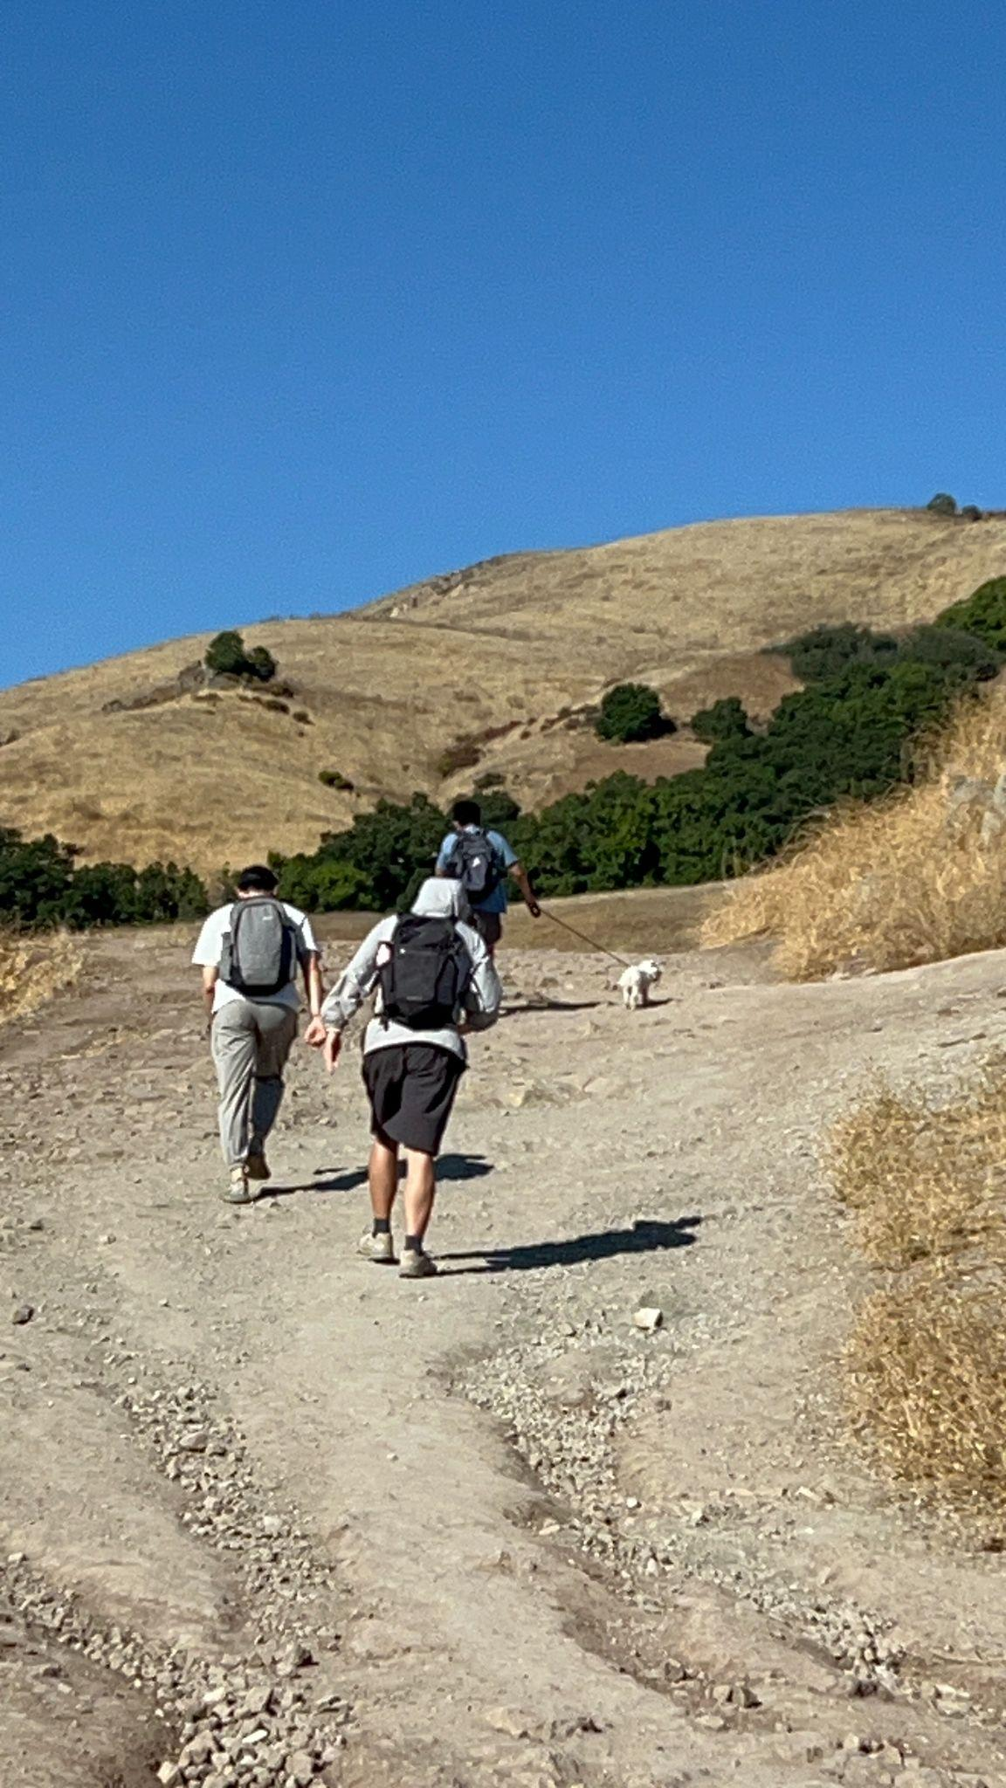
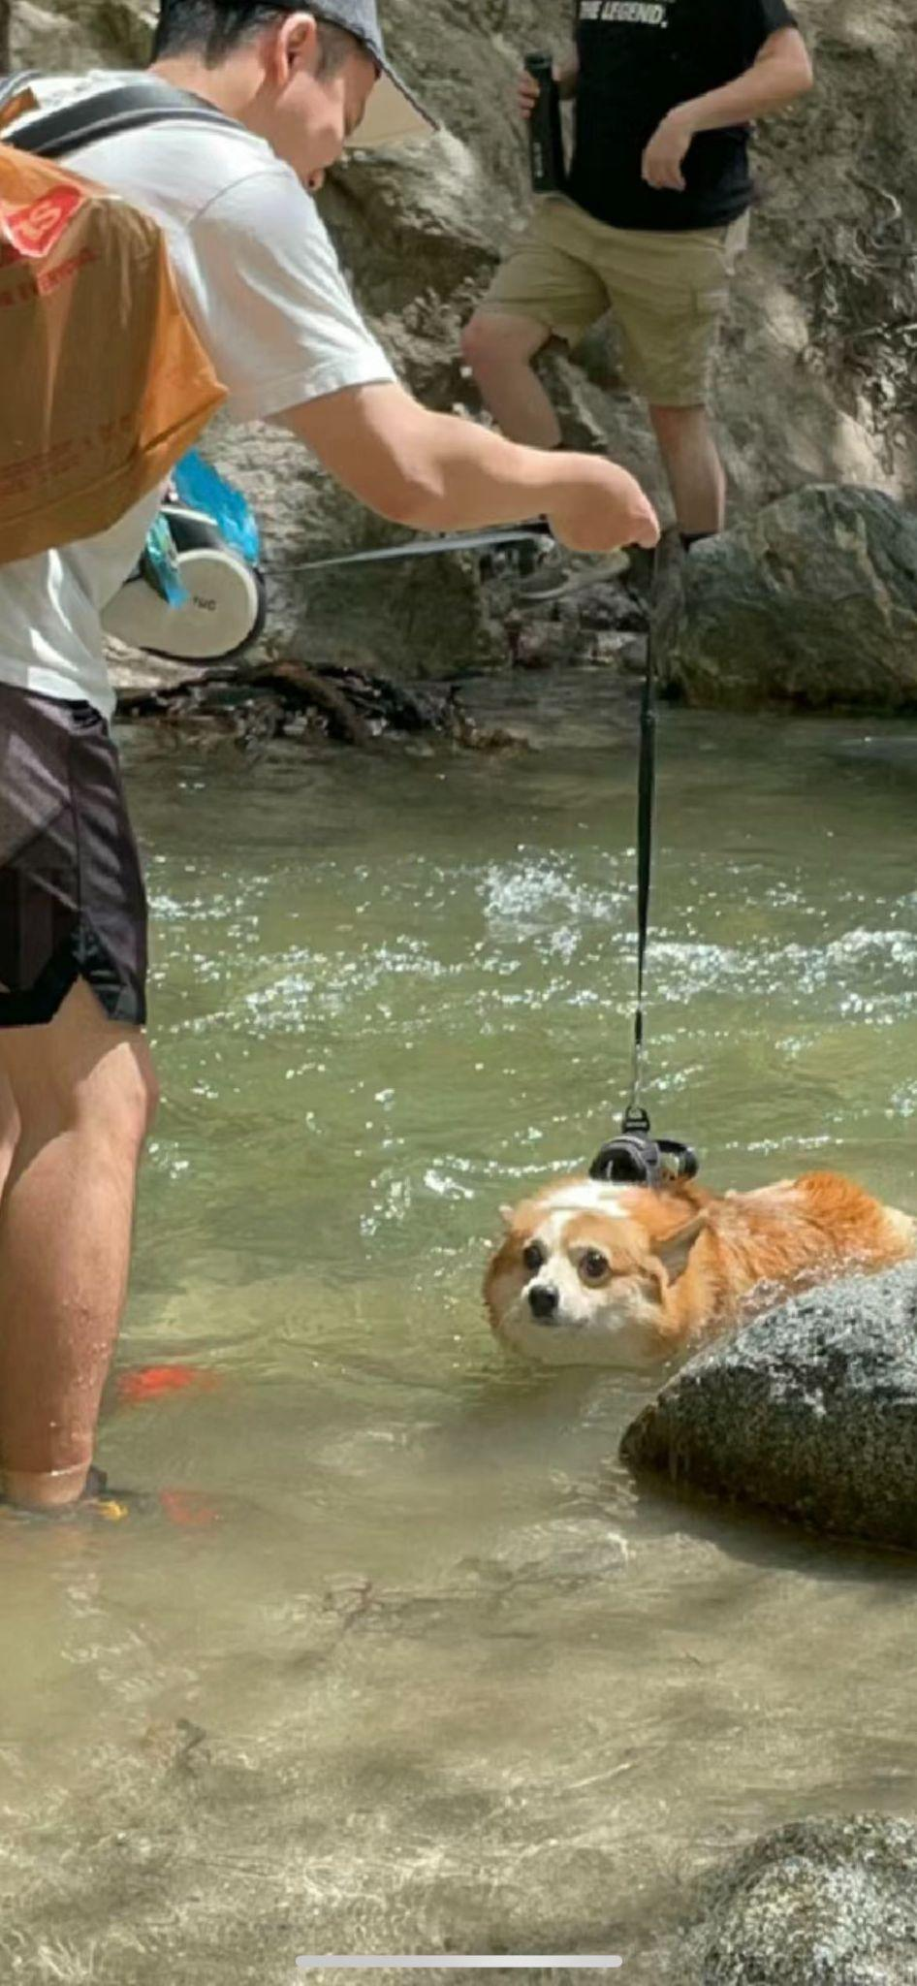
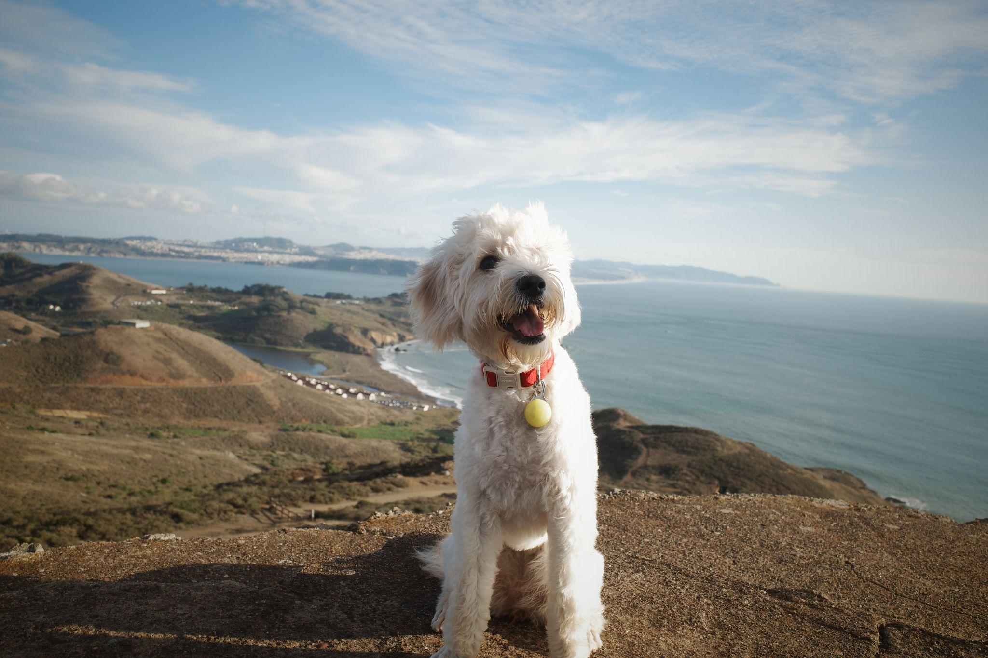
THANK YOU!
Do you have any questions?

